Slide 1
Visual Journal 2
Kelly Cheng
Mohamed Khaidir
Natalia Singa
Tan Der Ching

Slide 2
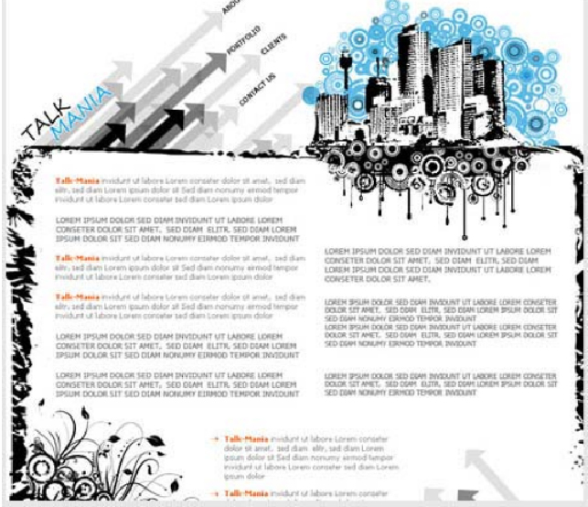
Design 1

Slide 3
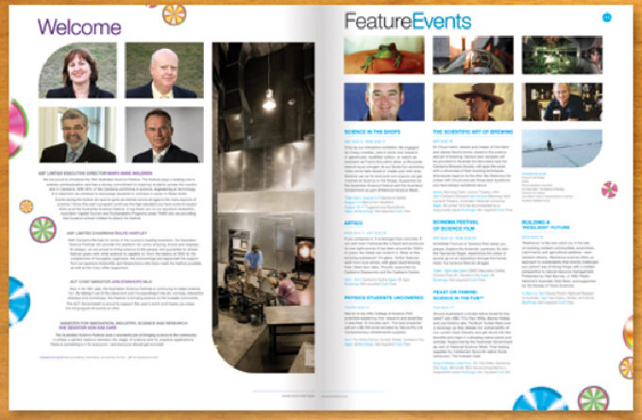
Design 2

Slide 4
Typography Design & Font
Design 1
Contrast
Font used for the title in the graphic was strokes with even width, which is suitable for a title because font with uneven strokes are only suitable for text, not title.
As the theme of the graphic was light blue and black, the combination of the two colors for the title is appropriate.
Repetition
Repetition of orange in color letters for the subtopic is useful for the viewers to notice the key points of the text.
Repetition of big letters in the text is also useful because the writer wanted to highlight important statement in the text. Not important statements are in the form of small letters where repetition of it also occurs.
Alignment
In the text, the alignment is left. It is better if the writer put the text in the form of justified alignment so the text can be seen, organized.
Proximity
For the overall proximity of the typography design in the graphic, it is good as the text are readable.
The proximity looks better if the text alignment are justified, not left.

Slide 5
Typography Design & Font
Design 2
Contrast
Font used for the title in the graphic was strokes with even width, which is suitable for a title because font with uneven strokes are only suitable for text, not title.
Repetition
It is good that this graphic practice repetition of color (purple) for it’s main title and subtitle at the left page of the graphic. It makes the reader’s eye ‘relax’ because of the repetition and the readers can notice the subtopic well.
At the right side of the page, there is no repetition of same color but repetition of same hue of color, blue for the title, and slightly lighter blue for the subtitle. This repetition would not lead the readers to become bored while viewing the image.
Alignment
Spiral alignment at the left page of the graphic for the text is unique and a fresh idea. Straight alignment is too mainstream.
It is better if the writer put the text in the form of justified alignment so the text can be seen, organized.
Proximity
For the overall proximity of the typography design in the graphic, it is good as the text are readable.
The proximity looks better if the text alignment are justified, not left.

Slide 6
Layout Design
Design 1
Contrast
There is a contrast in layout design. Vital information of ‘Talk Mania’ such as introduction, portfolio, clients and contact details are presented by the arrow whereas other information that requires longer detail is presented on an open page layout.
Repetition
There is a repetition of the word ‘Talk Mania’. This is to help readers to remember that the text they are reading is about Talk Mania.
Alignment
The text is flush-left. The spaces between each paragraph on the left side are consistent. However the spaces between each paragraph on the right side are not consistent.
Proximity
Vital information of ‘Talk Mania’ such as introduction, portfolio, clients and contact details are put at the top, suggesting its importance.

Slide 7
Layout Design
Design 2
Contrast
On the left side, texts are presented in a single column whereas on the right side, texts are presented in three columns. This is done so as there is more information that needs to included in 'Feature Events' compared to 'Welcome'.
Repetition
There is a repetition of colourful wheels. They are repeated on the left and right side of page to create balance.
Alignment
The text is flush-left. The spaces between each paragraph on the left side are consistent. The title of each page is legible.
Proximity
On the left side, pictures of people delivering a welcome message are grouped to together whereas on the right side, pictures of events are grouped together.

Slide 8
Colour Balance
Design 1
Contrast
The contrast between the plain white background and the poster’s content is good. The background allows everything else to standout, thus the audiences will be able to immediately acknowledge what’s most important.
A white background is used against everything else, there is no clashing in colours that may cause readers to struggle in reading.
The keywords in orange are also well contrasted from everything else as it is a warm tone with a striking opacity. It is effective because it successfully made its point in being the “important highlighted keywords”.
The background design uses some greys, blacks, and blues. The colour isn’t competitive; it is mellowed and doesn’t distract viewers from the main content. The blues used are just enough to grab the reader’s attention, but not distract them from the main content, as the colours used for the main text is already plain, monotonous, and boring.
Repetition
The idea of using the same orange colour for all “Talk Mania” keywords allows the readers to not be confused. It shows a consistent format, hence creates a very neat layout. Furthermore, there’s a lot of repeated usage of black colour in this layout. Although it portrays clarity and neatness, it is slightly boring and dull.
Alignment
The consistency of the colours are very neat. As said before, there is no clashing in colours between the different elements, which projects a neat usage of colours. However, as said before, the colour scheme used is boring and monotonous, as it majorly consists of black colour. Adding a little more colour to the decorative designs will enhance the overall look of the layout.

Slide 9
Colour Balance
Design 1
Proximity
There are more colourful elements on the top than the bottom. This may cause the readers to lose interest by the time they reach the other half of the layout; the big design on the top may have been the main reason readers decide to read the content of the poster in the first place.
My perspective & Argument
I think that the layout lacks excitement and attraction due to the poster design, colour, and placement of the elements.
The colours are not used wisely, as it is mainly black and white, which doesn’t benefit the fact that it has a lot of text. The decorative designs can be more colourful in a way that it attracts more attention to the layout.
The bottom part of the layout needs more colours to the designs to balance out the mood and liveliness of the layout.

Slide 10
Colour Balance
Design 2
Contrast
The contrast between the colourful content and the clean white background does the poster justice, as this allows the content to stand out and attract readers’ attention. There’s no distraction or clash in colours between the background and the content that may lead to difficulties in reading.
The main titles and paragraph titles, sub titles and highlighted keywords are more protruding due to the colours used against the black text (paragraph) and the white background. This helps project the difference between the main title, the paragraph title and its subsequent content; furthermore, the use of bright colours creates a more reader-friendly mood.
Moreover, the decorative designs on the sides of the layout balance out the cool tones of the font colour, as it consists of a mix of colour scheme, both warm and cool tones.
Repetition
The purple and the light blue in the text are overused. As we can see on both sides (left and right), not only are the main titles and paragraph titles highlighted in their respective colours (purple on the left, light blue on the right), even the subtitles and keywords in the paragraphs are highlighted in the same colour. This makes the colour less dominant and strong; it seems as though the sub titles and the highlighted keywords are under the same text category as ‘sub titles’. Also it makes the whole text look boring and monotonous.
On the other hand, the use of the same colour scheme for the decorative designs for both sides projects consistency, neatness and harmony to the eyes.

Slide 11
Colour Balance
Design 2
Alignment
The alignment of colours is good; having purple font colour on the left side and blue on the other allows the readers to acknowledge the difference in content of each side. The decorative designs are also consistent in their colours, having the same type of colours on both sides. Same goes to the cool toned filtered pictures, they project as a category on its own due to the mood of the colours; they are consistent in a way that they are cluttered in only one area and there are no sudden flashes of pinks, orange, reds, etc. All this allows the layout design to be very neat and easy to read and look at.
Proximity
In the aspect of colour balance, the proximity of this layout is very neat. Different types of colours are grouped correspondingly to what they represent. For example, all the photos have a cool filter, all the decorative designs on the sides have the same colour scheme, and same goes to the text in accordance to which side they’re on.

Slide 12
Colour Balance
Design 2
My perspective & argument
I liked how this poster turned out to be. However, if I were to do something about it, I would make sure the colour of the title, paragraph title and highlighted keywords are contrast enough to make a clear distinction of the format of the text.
For example: I liked how the main titles and paragraph titles are bold and bigger in text, allowing the blue and purple to look darker, which establishes them as titles from the rest of the text. The sub titles (under the paragraph titles) are still good to go because it’s not bold; it’s a lot lighter than the main titles. It shows a different category of text format.
However, the highlighted keywords cannot be the same as the colour of the sub title. It undermines the dominance of the sub title and it may be confusing to the readers. I would use a bright pink text colour for the keywords on both pages. So it won’t be confusing what they are, as elements, and the colour goes with the colour theme.

Slide 13
Consistency
Design 1
Contrast
The consistency of contrast is found in this design as black, grey, orange, and blue all contrast on the white background.
Repetition
Consistency of repetition is found in this design on some areas.
All subtitles consistently uses the colour orange to contrast from the background as well as the other text.
Repetition of San serif fonts are used in this design.
However the font colour is not consistent and it changes from grey to black.
The text casing are not consistent and changes from all caps to no caps.
Alignment
The alignment of text is not consistent through out the design.
The text on the left is flush left while the text on the right is justified.
Proximity
The proximity in this design is not consistent as the images are heavy towards the top and lighter towards the bottom.
The border on the left is rather rough while smooth on the right.
The images are also heavy towards the bottom left compared to the bottom right.

Slide 14
Consistency
Design 2
Contrast
The consistency of contrast is found in this design as black, purple, and blue all contrast on the white background.
Repetition
Consistency of repetition is found in this design on some areas.
Title and important keywords on the left are purple in colour and on the right are in blue.
Repetition of San serif fonts are used in this design.
The text casing are not consistent and changes from all caps to no caps.
Alignment
The alignment of text is consistent through out the design. The text are all flush left.
Proximity
The proximity in this design is consistent as the images are heavy towards the top and lighter towards the bottom.
The design of the circles are spread out evenly on both sides.

Slide 15
Consistency
Design 1 & 2
My perspective & argument
Both design had flaws in their consistency.
But consistency is found more frequently in design 2 rather than design 1.
Both were consistent on the font family, using only san serif fonts.
Both used contrasting colours between the background and text, as well as titles and keywords with normal text.
Both designs would be more consistent if they had use the appropriate caps. Instead of randomly changing it in the middle of sentences.
Design 1 should have a consistent alignment as in design 2. However both should use justified as their alignment to keep it tidy.
Design 1 should take in account the image placement to increase consistency in its proximity.
Overall I concluded that base on consistency, design 2 is better than design 1.

Slide 16
End

